Slide 1
Rockbuster Stealth
Marvin Krenge
16 January 2024
A Strategy to a successful
launch

Slide 2
Background & Objectives
Rockbuster Stealth LLC is a movie rental company that has store all around the world.
Because of tough competition like Netflix, Disney Plus or Amazon Prime, they need to expand to an online video rental service in order to stay competitive.

Slide 3
Slide Overview
Data Overview
Statistics of Film Rental
Most Revenue by Genre
Most Revenue by Rating
Most & Least Revenue Movies
Most Customers by Country
Revenue by Geographical Regions
Most & Least Revenue Countries
Loyalty Reward for Top 5 Customer
Recommendation

Slide 4
Data Overview
Movies: 1000
Customers: 599
Countries: 109
Movie Language: English
Release Year: 2006
Store Location: Australia and Canada

Slide 5
Statistics of Film Rental
Rental Rate
Minimum | 0,99
Average | 2,98
Maximum | 4,99
Rental Duration
Minimum | 3
Average | 4,99
Maximum | 7
Rental Rate
Minimum | 46
Average | 115,27
Maximum | 185
Rental Rate
Minimum | 9,99
Average | 19,98
Maximum | 29,99

Slide 6
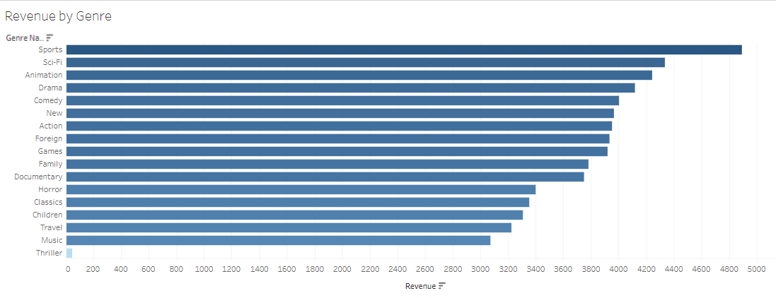

Most Revenue by Genre

Slide 7
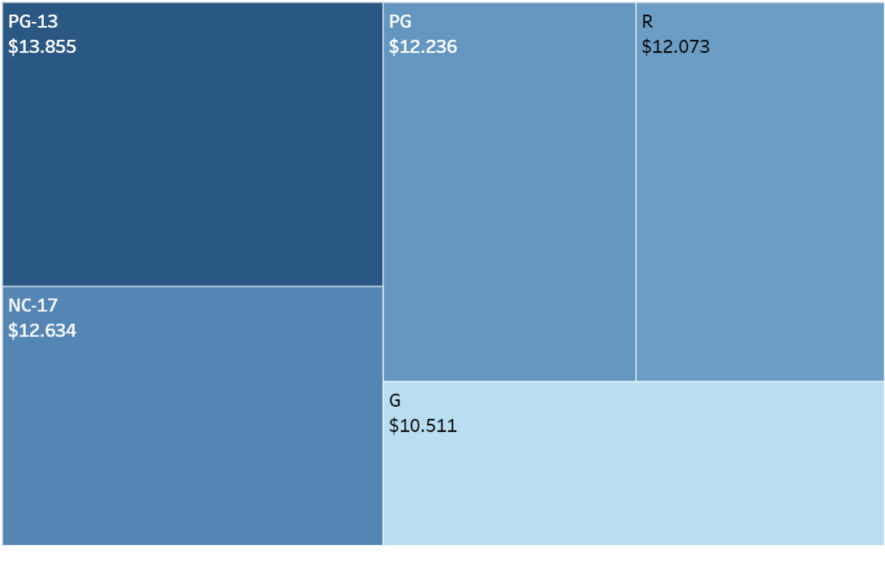

Most Revenue by Rating
Rating | Revenue ($)
PG-13 | 13856
NC-17 | 12635
PG | 12237
R | 12073
G | 10512

Slide 8
Most & Least Revenue Movies
Top 10 Movies
Telegraph Voyage | 215,75
Zorro Ark | 199,72
Wife Turn | 198,73
Innocent Usual | 191,74
Hustler Party | 190,78
Saturday Lambs | 190,74
Titans Jerk | 186,73
Harry Idaho | 177,73
Torque Bound | 169,76
Dogma Family | 168,72
Bottom 10 Movies
Texas Watch | 5,94
Oklahoma Jumanji | 5,94
Duffel Apocalypse | 5,94
Freedom Cleopatra | 5,95
Young Language | 6,93
Rebel Airport | 6,93
Cruelty Unforgiven | 6,94
Treatment Jekyll | 6,94
Lights Deer | 7,93
Stallion Sundance | 7,93

Slide 9
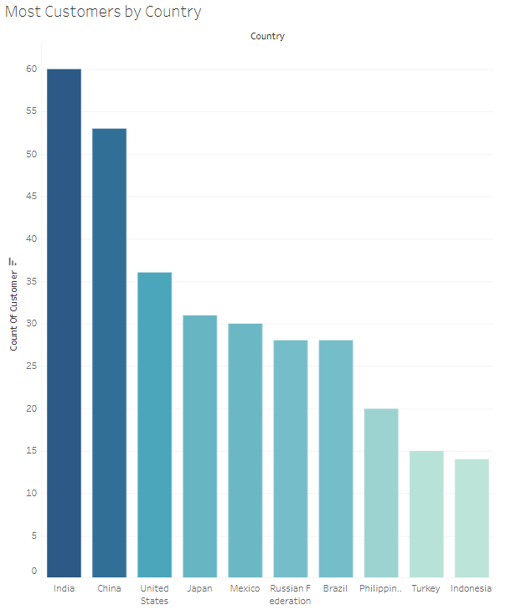

Most Customers by Country
India | 60
China | 53
United States | 36
Japan | 31
Mexico | 30
Russia | 28
Brazil | 28
Philippines | 20
Turkey | 15
Indonesia | 14

Slide 10
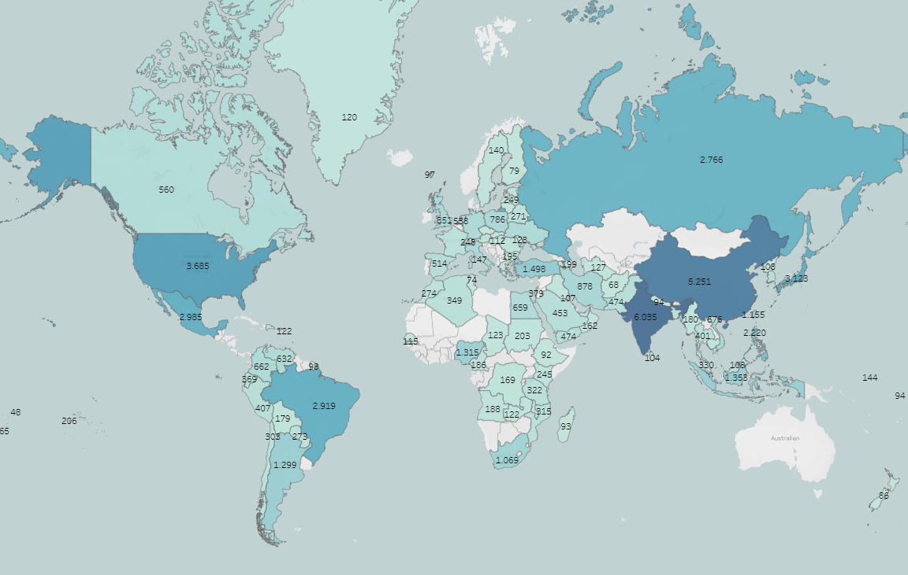

Revenue by Geographical Regions
Sales show variation across geographic regions
Notably higher sales in countries with higher population

Slide 11
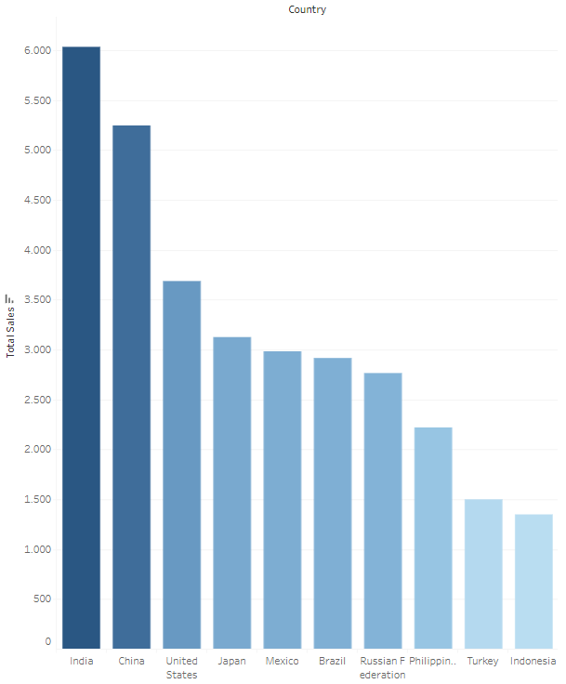

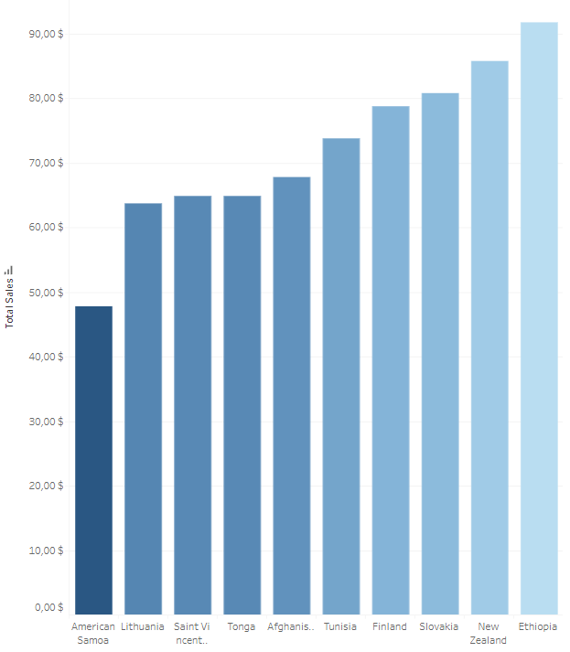

Most & Least Revenue Countries

Slide 12
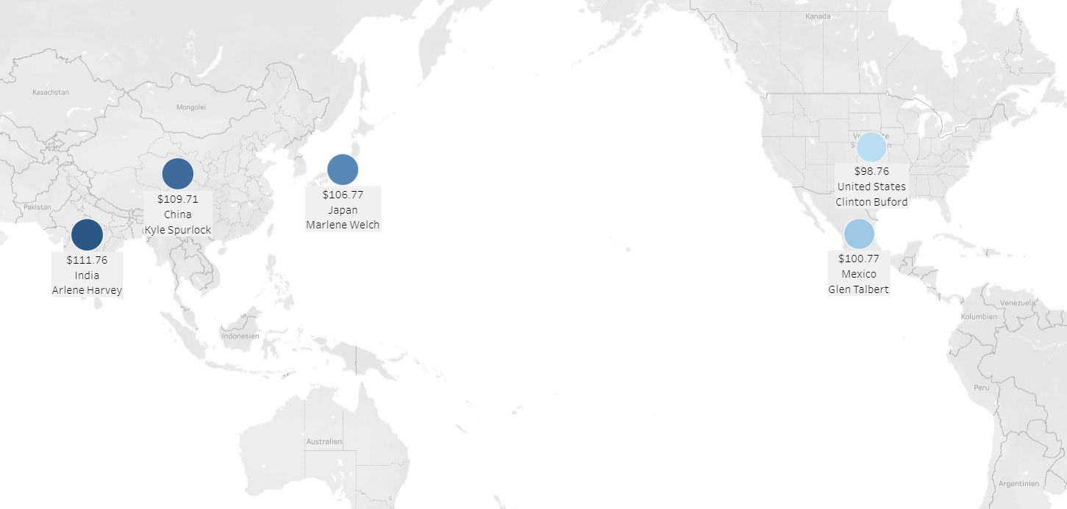

Loyalty Reward for Top 5 Customer
Country | City | Amount ($)
India | Ambattur | 111,76
China | Shanwei | 109,71
Japan | Iwaki | 106,77
Mexico | Acua | 100,77
U.S. | Aurora | 98,76

Slide 13
Recommendation
Most popular Film Rating: PG-13
Most revenue genres: Sports, Sci-Fi and Animation
These results show that Rockbuster should focus on more likely on these genres and at best with a PG-13 film rating to get the best results for the launch.
Most customers come from large population countries like India, China, U.S., Japan, Brazil,…
The most loyal customer base comes also from India and China
These results suggest that Rockbuster should focus mainly on the big population countries and especially India and China, because of the high loyalty customer count.

Slide 14
Thank you!
Marvin Krenge

Slide 15
Appendix
Find the Visualizations
Here:
Tableau

